Slide 1
CS5590 Applied Programming Series
Programming for Web/Cloud based Application

Slide 2
RESPONSIVE WEB DESIGN
JAVASCRIPT

Slide 3
Responsive Web Design

Slide 4
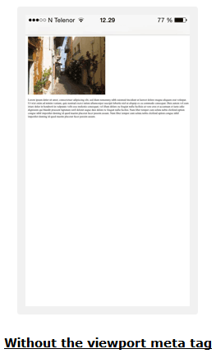
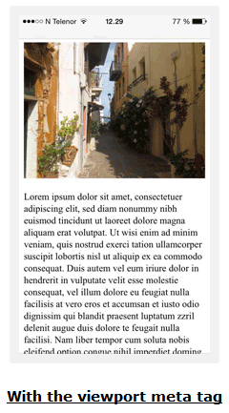
RWD-Viewport
<meta name="viewport" content="width=device-width, initial-scale=1.0">

Slide 5
RWD-Media Queries
SYNTAX
@media not|only mediatype and (expressions) { CSS-Code; }
Mediatype- all,print, screen, speech
EXAMPLE
@media screen and (min-width: 480px) { body { background-color: lightgreen; } }

Slide 6
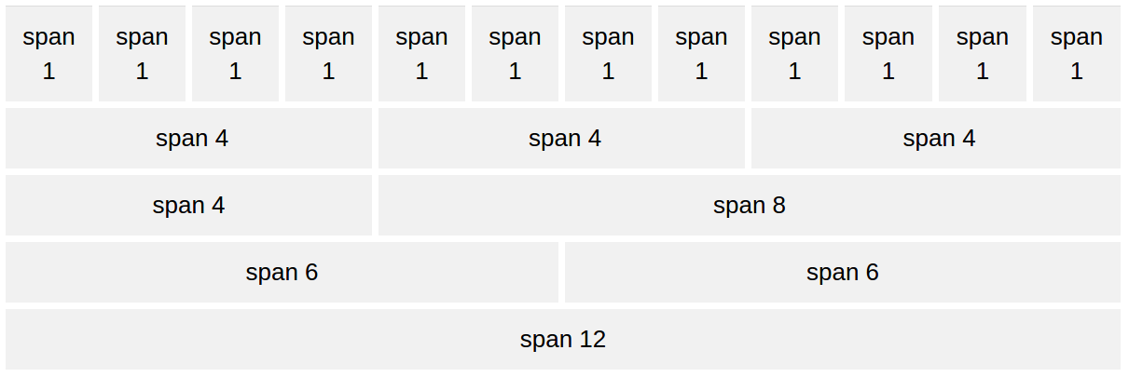
RWD-Grid View

Slide 7
RWD-Grid View
Entire body is to be placed in a div which contains rows that are in turn made up of columns
The count of columns in a row should total to 12 and their width to 100%
.col-1 {width: 8.33%;} through
.col-12 {width: 100%;}

Slide 8
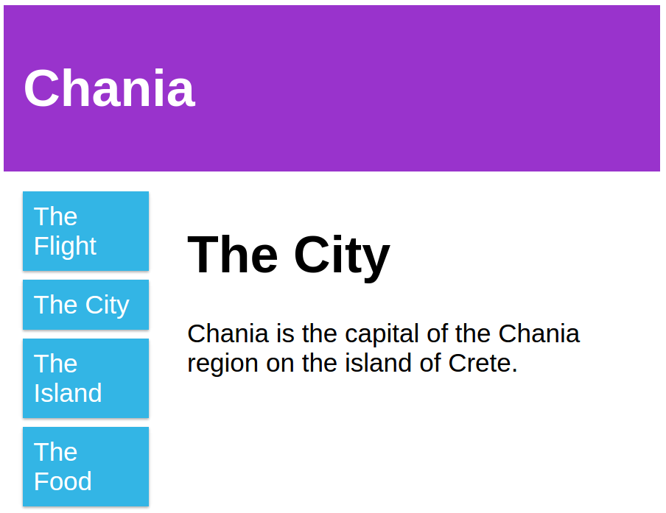
Without Bootstrap

Slide 9
CSS
<meta name="viewport" content="width=device-width, initial-scale=1.0">
<style>
* {
box-sizing: border-box;
}
.row::after {
content: "";
clear: both;
display: table;
}
[class*="col-"] {
float: left;
padding: 15px;
}
.col-1 {width: 8.33%;}
.col-2 {width: 16.66%;}
.col-3 {width: 25%;}
.col-4 {width: 33.33%;}
.col-5 {width: 41.66%;}
.col-6 {width: 50%;}
HTML
<div class="header">
<h1>Chania</h1>
</div>
<div class="row">
<div class="col-3 menu">
<ul>
<li>The Flight</li>
<li>The City</li>
<li>The Island</li>
<li>The Food</li>
</ul>
</div>
<div class="col-9">
<h1>The City</h1>
<p>Chania is the capital of the
Chania region on the island of Crete.</p>
</div>
</div>

Slide 10
CSS
.col-7 {width: 58.33%;}
.col-8 {width: 66.66%;}
.col-9 {width: 75%;}
.col-10 {width: 83.33%;}
.col-11 {width: 91.66%;}
.col-12 {width: 100%;}
html {
font-family: "Lucida Sans", sans-serif;
}
.header {
background-color: #9933cc;
color: #ffffff;
padding: 15px;
}
.menu ul {
list-style-type: none;
margin: 0;
padding: 0;
}
.menu li {
padding: 8px;
margin-bottom: 7px;
background-color: #33b5e5;
color: #ffffff;
box-shadow: 0 1px 3px rgba(0,0,0,0.12), 0 1px 2px rgba(0,0,0,0.24);
}
.menu li:hover {
background-color: #0099cc;
}

Slide 11
Bootstrap
Developed at Twitter and open sourced in 2011
HTML, CSS, and JS framework for developing responsive, mobile first projects on the web
Grid view in bootstrap CSS
is the same as in normal CSS except that we have predefined class names.

Slide 12
Bootstrap-Grid View
Rows must be placed within a .container or .container-fluid for proper alignment and padding.
Use rows to create horizontal groups of columns.
Content should be placed within columns, and only columns may be immediate children of rows.

Slide 13
Bootstrap-Grid View
HTML
<div class="container">
<div class="row">
<div class="col-md-12"> <h1>Chania</h1>
</div>
</div>
<div class="row">
<div class="col-md-3 menu">
<ul>
<li>The Flight</li>
<li>The City</li>
<li>The Island</li>
<li>The Food</li>
</ul>
</div>
<div class="col-md-9">
<h1>The City</h1>
<p>Chania is the capital of the
Chania region on the island of Crete.</p>
</div>
</div>

Slide 14
Bootstrap-Grid View
As bootstrap has classes defined already, we don’t need to specify any styling for the grid explicitly in our code
This makes bootstrap very useful for responsive web development

Slide 15
JavaScript Basics

Slide 16

DOM
presents an HTML document as a tree structure

Slide 17
DOM
Everything in an HTML document is a node.
Document Node : Entire Document
Element Node : HTML tags
Text Node : Texts in element node
Attribute Node : HTML attribute
Comment Nodes
Defines a standard way for accessing and manipulating HTML documents

Slide 18
JavaScript
HTML and CSS are used to define the content and layout of web pages
JavaScript is to program the behavior of web pages
It can change HTML content, attribute, style of any element

Slide 19
Changing Content
<p id="demo">JavaScript can change HTML content.</p>
document.getElementById("demo").innerHTML = "Hello JavaScript";
Output:
<p id="demo">Hello JavaScript!</p>

Slide 20
Variables
containers for storing data values.
var <variableName> = <someValue>
var age=23;
var firstName ="bob";
'var' declares new variable for all data types

Slide 21
Operators
var x=5%2; // x value is 1
var x= "cs" +"5590"// x value is "cs5590"
var x=10;// x value is 10
x+=5; // x value is 15
x++ // x value is 16
x--// x value is 15

Slide 22
Comparison
Operator | Description
== | equal to
=== | equal value and equal type
!= | not equal
!== | not equal value or not equal type
> | greater than
< | less than
>= | greater than or equal to
<= | less than or equal to
? | ternary operator

Slide 23
Data types
Primitive Data
string
number
boolean
null
undefined
Complex Data
Function
object

Slide 24
Strings
var carName = "Volvo XC60";
var carName = 'Volvo XC60';
var answer = "It's alright"
var x = 16 + 4 + "Volvo";-->20Volvo
var x = "Volvo" + 16 + 4;-->Volvo164

Slide 25
Numbers
only one type of numbers.
can be written with, or without decimals
var x1 = 34.00;
var x2 = 34;
var y = 123e5; // 12300000 var z = 123e-5; // 0.00123

Slide 26
Booleans
can only have two values: true or false.
var x = true; var y = false;

Slide 27
Booleans
Evaluates to 'true' | Evaluates to 'false'
true | false
Non zero number | zero
string | “”
objects | undefined
arrays | null
functions | Not a Number

Slide 28
Undefined, Null
var person; // Value is undefined
var person = null;
// Value is null, but type is still an object
Undefined vs Null
typeof undefined // undefined typeof null // object null === undefined // false null == undefined // true

Slide 29
== Vs ===
== is used to check if two values are equal irrespective of their data types
=== is used to check if two values are equal based on both value and data type
x== "5" //returns true
x=== "5" //returns false

Slide 30
Arrays ,Objects
var cars = ["Saab", "Volvo", "BMW"];
Array indexes are zero-based
var person = {
firstName: "John",
age: 50,
}
Objects are name:value pairs, separated by commas.

Slide 31
pop(),push ()
var fruits = ["Banana", "Apple", "Mango"];
var x = fruits.pop(); // value of x is "Mango"
var fruits = ["Banana", "Apple"]
var x = fruits.push("Kiwi"); // x=3
Push returns the new length of array

Slide 32
toString(), length
toString() converts array to string
var fruits = ["Banana", "Orange", "Kiwi"];
Var s = fruits.toString();
//s value is "Banana,Orange,Kiwi"
Length property gives length of array
Var lth =s.length // lth value is 3

Slide 33
splicing()
var fruits = ["Banana", "Mango", "Kiwi"];
var fruits = fruits.splice(1, 1, "berry");
//fruits=["Banana", "berry", "Kiwi"];
1-->position where new element is added
1-->how many elements should be removed
Rest of parameters-->elements to be added

Slide 34
Type Conversion
String()->converts given datatype to string
String(false) // returns "false"
toString()
(100 + 23).toString()// returns "123"
Number("3.14")// returns 3.14
parseFloat()-> String to float
parseFloat("10.5")/ returns 10.5
parseInt()->String to integer
parseInt(“10.5”)// returns 10

Slide 35
Function
function myFunction(p1, p2) { return p1 * p2; // The function returns the product of p1 and p2 }
Function stops execution after return statement
myFunction(2,3)// returns 6 ->invocation

Slide 36
Conditions
If Statement
if (hour < 18) { greeting = "Good day"; }
else-if Statement
if (time < 10) { greeting = "Good morning"; } else if (time < 20) { greeting = "Good day"; } else { greeting = "Good evening"; }
If-else Statement
if (hour < 18) { greeting = "Good day"; } else { greeting = "Good evening"; }

Slide 37
Switch Statement
switch (new Date().getDay()) { case 0: day ="Sunday"; break; case 6: day = "Saturday";
break;
default:
day ="Working Day"; }

Slide 38
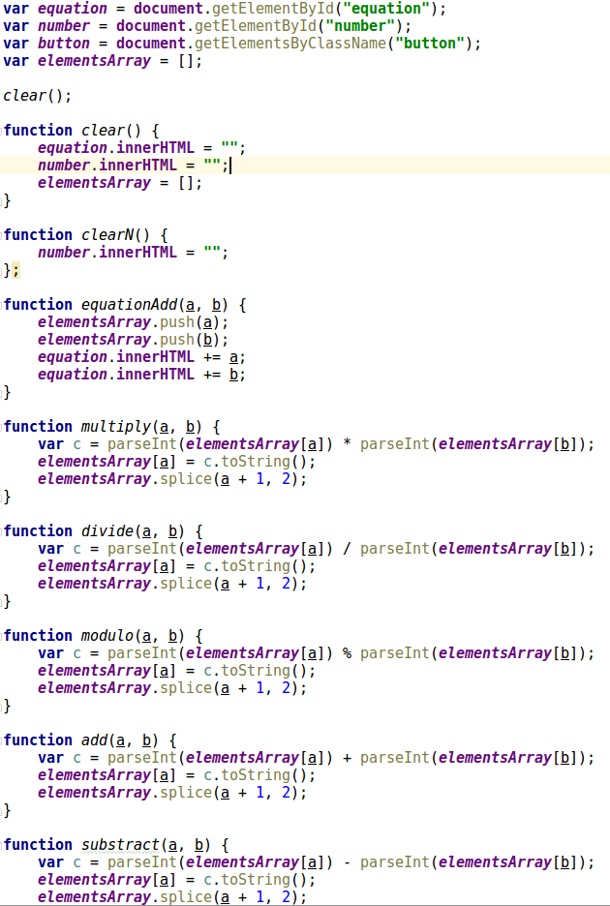
UseCase:Calculator

Slide 39
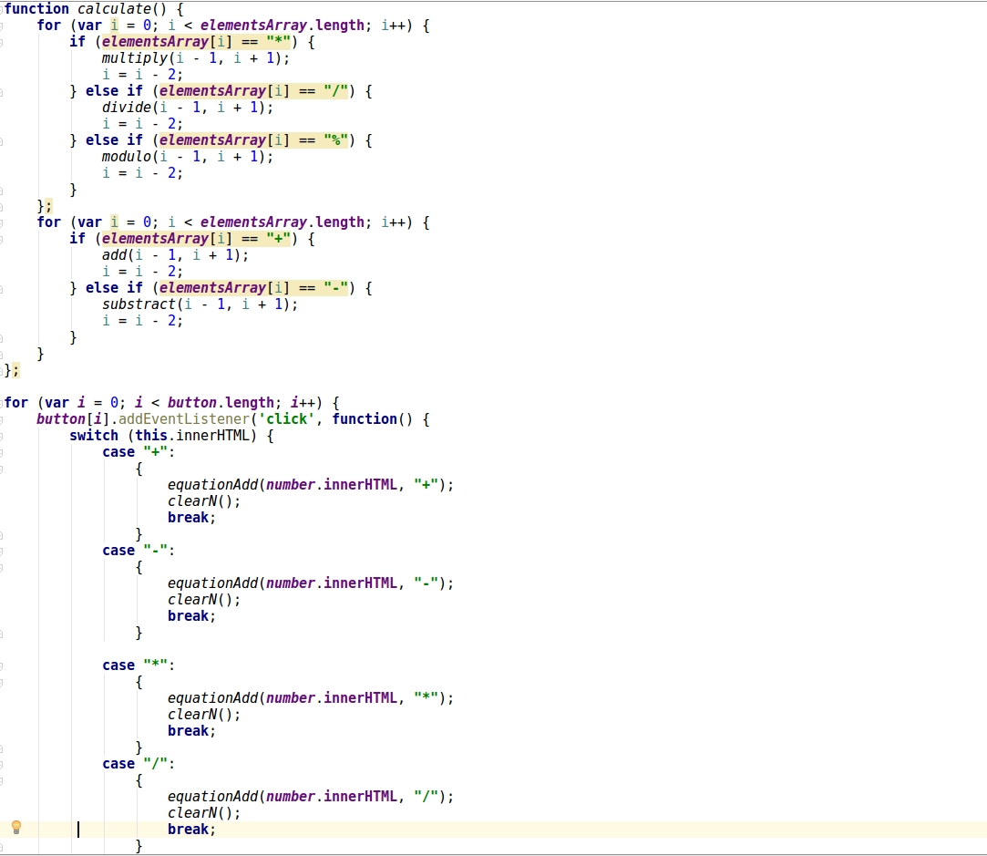
UseCase:Calculator

Slide 40
In Class Programming-1 Rock Paper Scissors
Build the game of rock paper scissors using JavaScript
Helpful links
https://en.wikipedia.org/wiki/Rock%E2%80%93paper%E2%80%93scissors
https://developer.mozilla.org/en-US/docs/Web/JavaScript/Reference/Global_Objects/Math/random

Slide 41
In Class Programming-2 RWD Task
Create a page which looks similar to this mockup. Download the starter code from here. Follow the TODO instructions in the input file. Make the page responsive and check its responsiveness as the screen size decreases.
The font in the mockup looks different from what we have now. Find the closest possible font to the one in the mockup and replace the existing font with it(Hint: Visit https://fonts.google.com/ and look for "Play", "Rambla", "Lato," "Orbitron" . One of them might be the font we need!)

Slide 42
Assignment
Assignment:
https://umkc.box.com/s/kbvx192ov712b27hjfe705qeevlsabhe
Submission Link: https://goo.gl/forms/cDmMhPECPYLAsSSh2

Slide 43
References
https://www.w3schools.com
https://github.com/Annno/Calculator-VanillaJS
https://www.udacity.com/
http://www.hongkiat.com
https://ariya.io
https://css-tricks.com
http://www.corelangs.com
http://getbootstrap.com/

